Slide 1
BDSA
2024
Start of Season Webinar

Slide 2
Running Sheet
BDSA information - Richard
BDSA Handbook
BDSA Club/Coach Handbook
QR Code page
Calander
Coaches Obligations – Neville
Club Obligations – Herman
Teams Sheet Process – Mark
Post Games: Voting/Referees – Tracy
Tribunal/appeals - Howard
Question Time

Slide 3
Topic: BDSA information
Presenter: Richard
Notes:
BDSA Handbook
BDSA Club/Coach Handbook
QR Code page
Calander

Slide 4
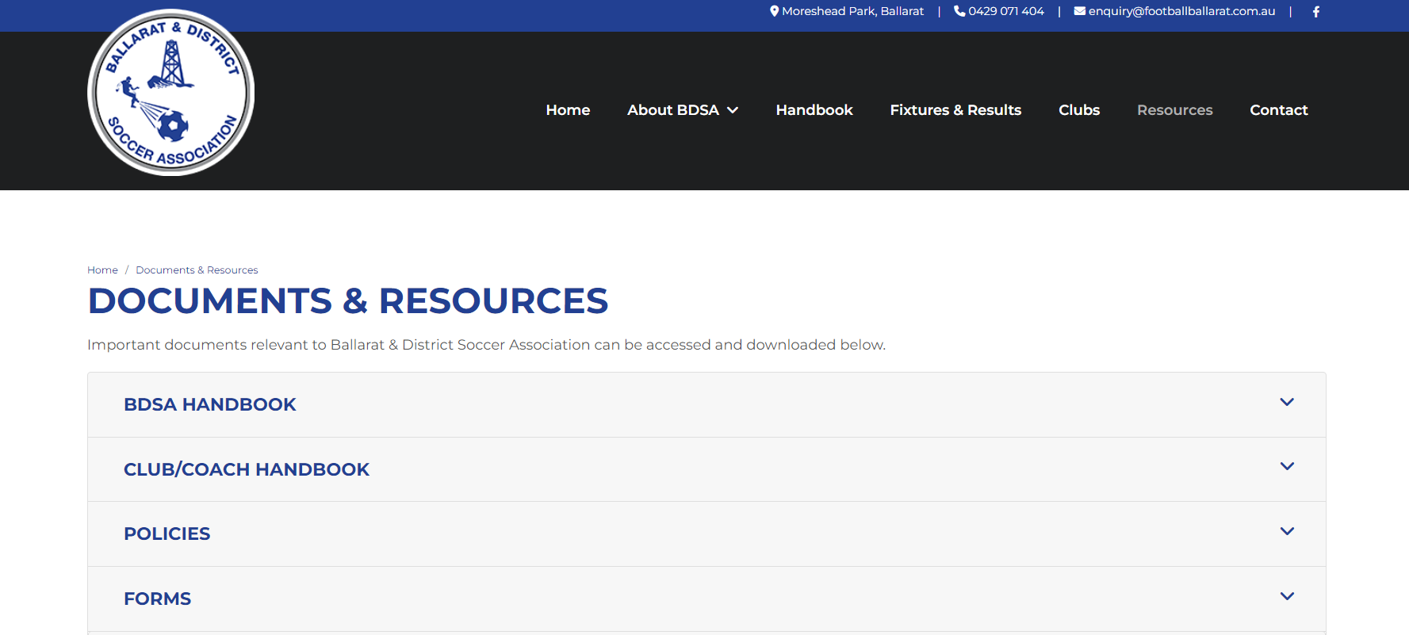
BDSA information
New Website: www.FootballBallarat.com.au
Under Resources
Notes:
BDSA Handbook
BDSA Club/Coach Handbook
QR Code page
Calander

Slide 5
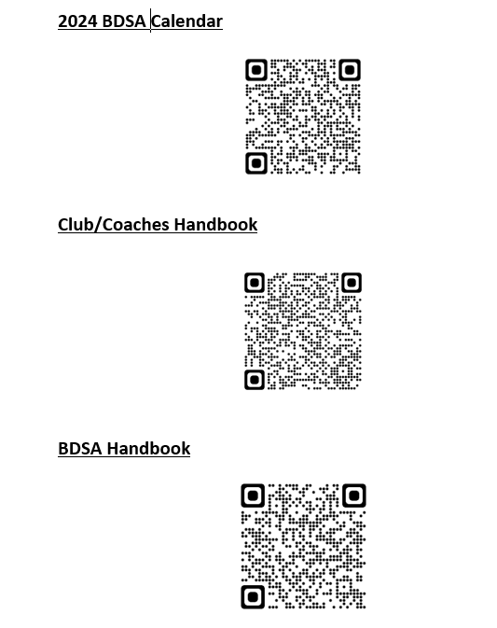
BDSA information
BDSA will send hardcopies to each club
BDSA handbook
Club/Coaches handbook
QR Code Sheet
Notes:
BDSA Handbook
BDSA Club/Coach Handbook
QR Code page
Calander

Slide 6
Topic: Coaches Obligations
Presenter: Neville
Notes:
BDSA Handbook
BDSA Club/Coach Handbook
QR Code page
Calander

Slide 7
Coaches Obligations
Complete teams sheets
Home Team / Away team
Strips (Uniform for Home and Alternative)
WWC recorded by club
Club B&F votes (best to have 3 spectators vote per game)
Refereeing Home games if none provided
It’s a game.
Any incidents, must be reported to the BDSA. Via Teamsheet, and/or Admin@ admin@footballballarat.com.au, secretary@footballballarat.com.au
Process of Game venue changes/Forfeits.
(Recommend you have a team manager)
Notes:
BDSA Handbook
BDSA Club/Coach Handbook
QR Code page
Calander

Slide 8
Topic: Club Obligations
Presenter: Herman
Notes:
BDSA Handbook
BDSA Club/Coach Handbook
QR Code page
Calander

Slide 9
Club Obligations
Ground Marshalls
Referees if none provided.
Alcohol at U18 games
First aid/stretches
Multiple teams in one Div from one team. 5 weeks to lock in players for 1 team.
Unable to train/play on home ground during season. Ability to use Morshead at no charge.
Toilets must be open and accessible for all GAMES
Ability to purchase drinks/food etc.
Notes:
BDSA Handbook
BDSA Club/Coach Handbook
QR Code page
Calander

Slide 10
Topic: Teams Sheet Process
Presenter: Mark
Notes:
BDSA Handbook
BDSA Club/Coach Handbook
QR Code page
Calander

Slide 11
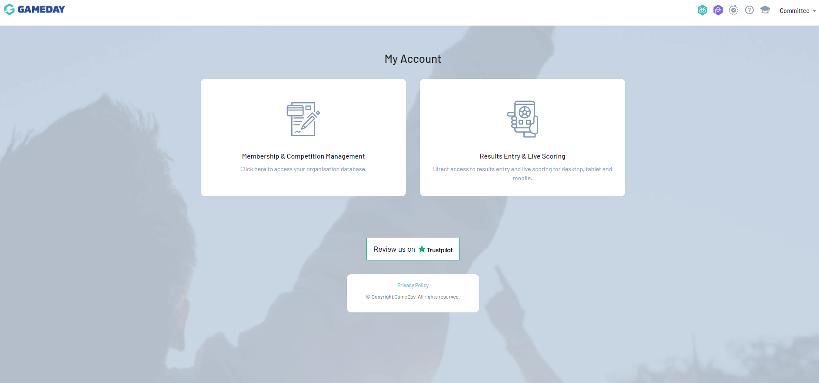
Gameday Team Sheets
https://mygameday.app/

Slide 12
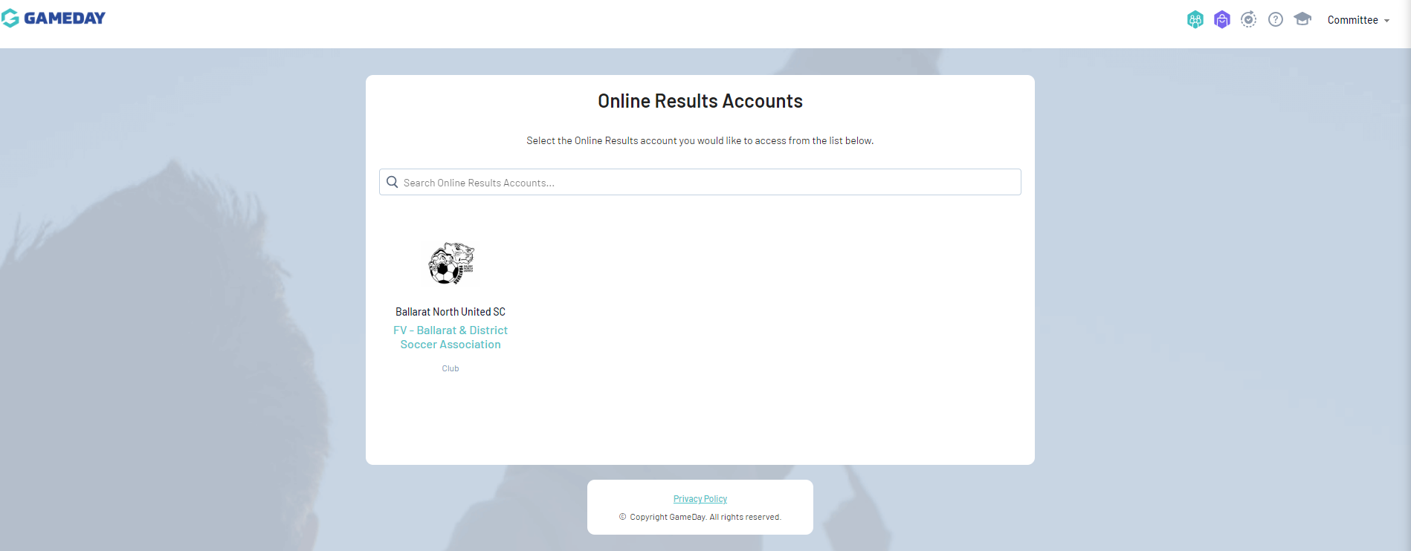
Gameday Team Sheets

Slide 13
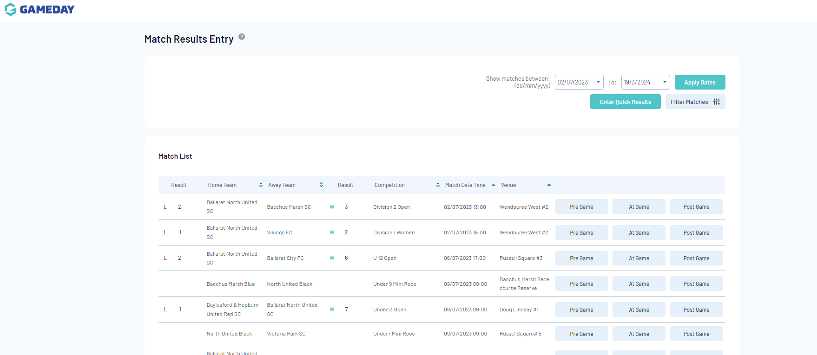
Gameday Team Sheets

Slide 14
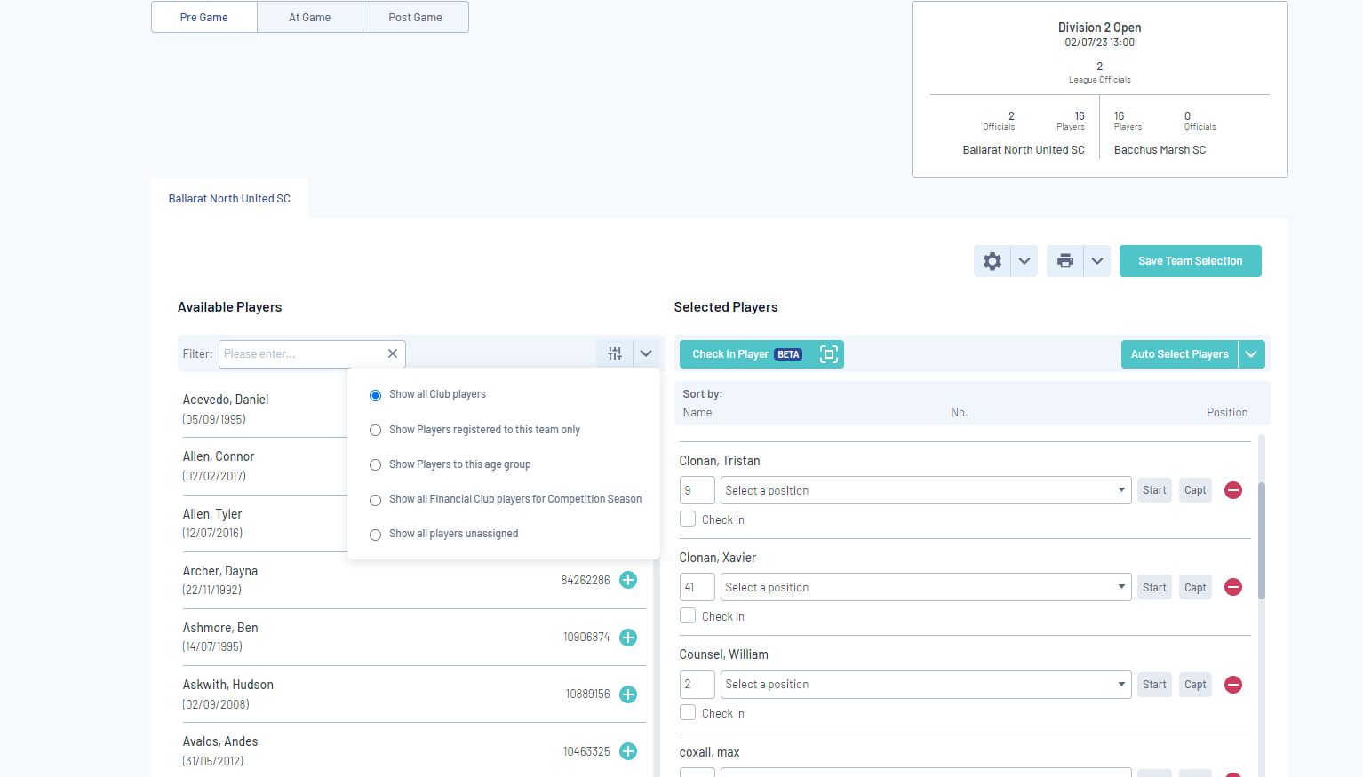
Gameday Team Sheets – Pre Game

Slide 15
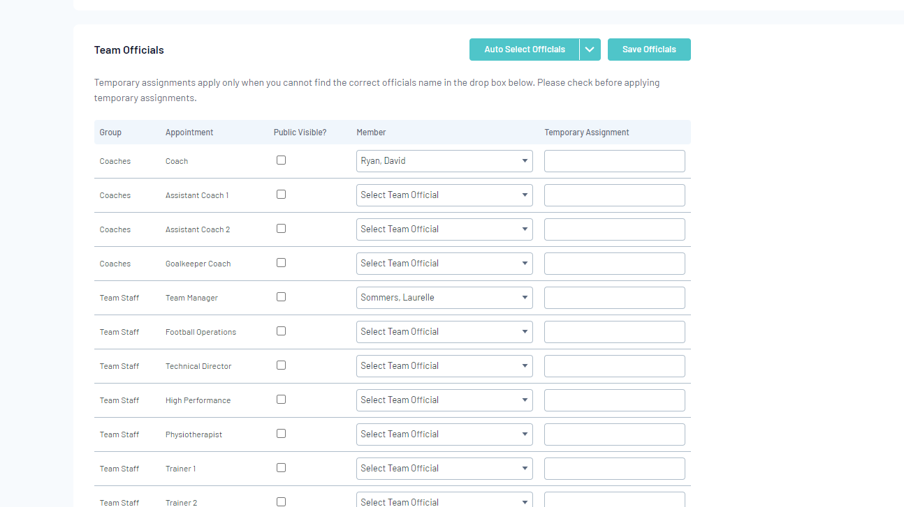
Gameday Team Sheets – Pre Game

Slide 16
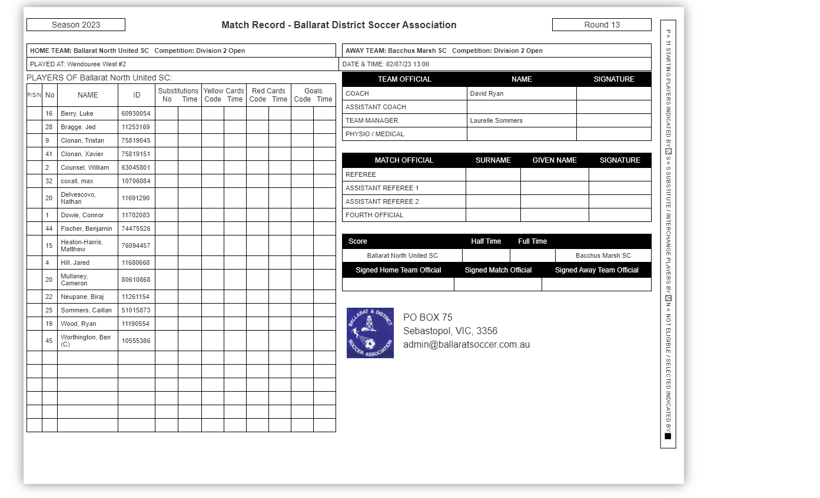
Gameday Team Sheets – Pre Game
Select BDSA Teamsheet
Print 2 copies
Print in Landscape

Slide 17
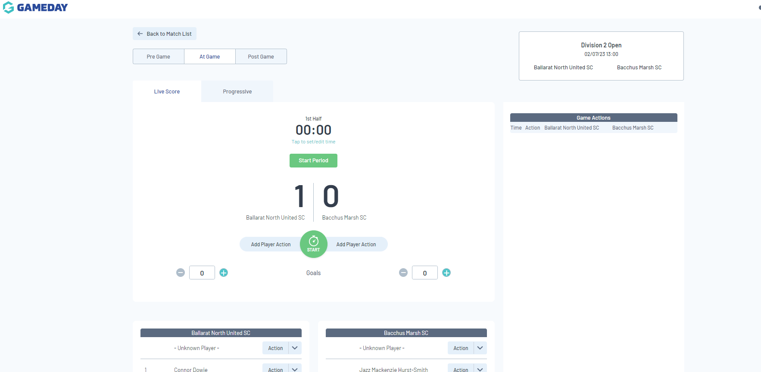
Gameday – At Game
Optional

Slide 18
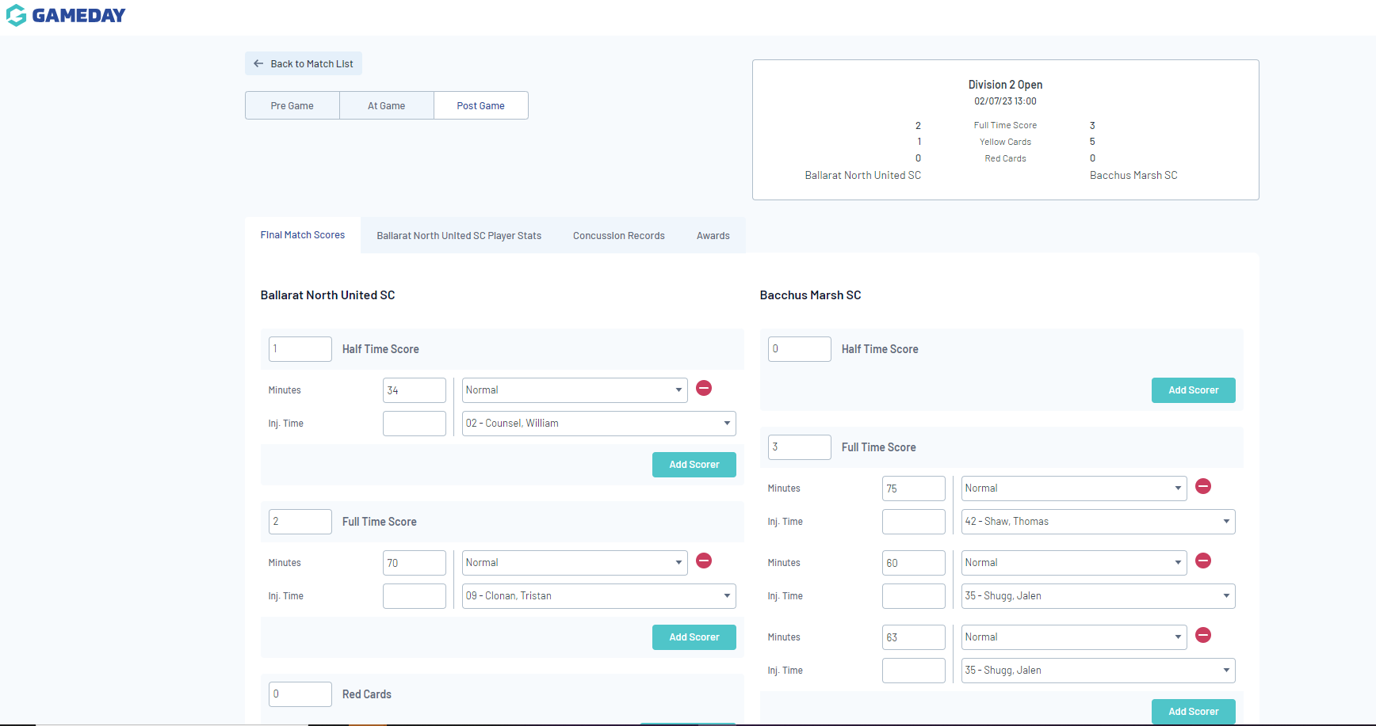
Gameday – Post Game (No official Referee)
Total Score HT & FT
Goal Scorer (inc Time)
Cards (inc time)

Slide 19
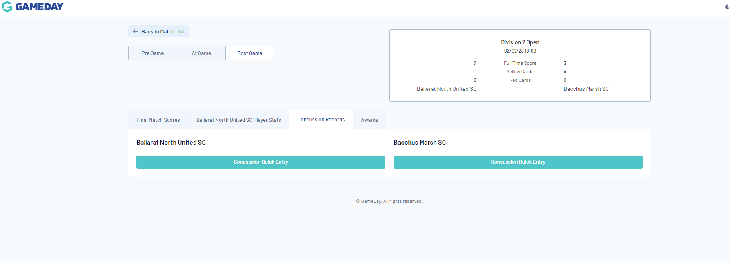
Gameday Concussion Record

Slide 20
Topic: Post Games: Voting/Referees
Presenter: Tracy
Notes:
BDSA Handbook
BDSA Club/Coach Handbook
QR Code page
Calander

Slide 21
Post Games: Voting/Referees
Post Game (No official Referee)
Send to admin@footballballarat.com.au
Photo of completed team sheet
Best and Fairest Votes
Match Details- BNUSC V BMSC Div 2 Round 12
3-2-1 (Incl Player Name, FA Number, Playing Number, Team
3 – 6595847, Mark Powell (7), BNUSC
2 – 000001, Herman Bogers (14), BMSC
1- 225151, Richard Stute (10), BNUSC
Any Matchday incidents that require follow up from BDSA

Slide 22
Post Games: Voting/Referees
Post Game (All Competitive games)
Bill Dejong Votes
Referee feedback
When referee’s are provided
Voted on by Club/Coach of game
Used by Michael to development referees

Slide 23
Topic: Tribunal/appeals
Presenter: Howard
Notes:
BDSA Handbook
BDSA Club/Coach Handbook
QR Code page
Calander

Slide 24
Tribunal/appeals
General process of Red cards
Process of appeal

Slide 25
Topic: Question Time
Presenter: Richard
Notes:
BDSA Handbook
BDSA Club/Coach Handbook
QR Code page
Calander

Slide 26
Thank-you for your time (this recording will be posted on our website shortly)
Notes:
BDSA Handbook
BDSA Club/Coach Handbook
QR Code page
Calander

